Slide 1
Structural biology and bioinformatics in drugdesigns
Taiga Kuroiwa
CS – 492 – Bioinformatics Article Explanation Presentation
http://rstb.royalsocietypublishing.org/content/361/1467/413.short

Slide 2
Contents of this slideshow
1. Background of background
2. Background
3. Profiling the structure and folding
4. Target validation and identification
5. Lead Discovery

Slide 3
Background of Background

Slide 4
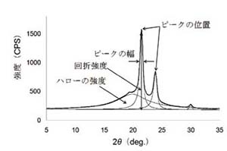
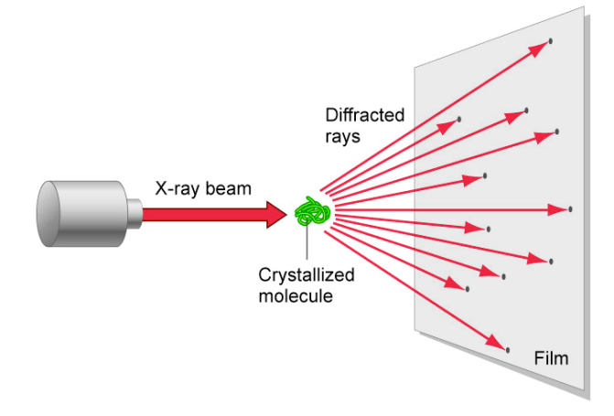
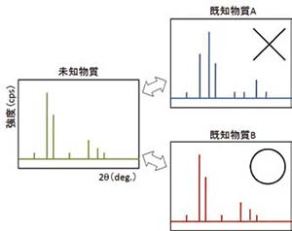
X-ray Crystallography
Get crystalized material
Hit Xray
Define the diffracted rays
In our case, we focus on structures of proteins

Slide 5
Structural Biology we may share same bed
Basics
Problems
1. Study structure of nuclear acid, and proteins
2. Uses
1. NMR
2. X-ray Crystallography
3. Electron microscope.
Crystallizing proteins are not that easy
Only knows the structure, and their possible effects are total different topic
Relatively new (since around 1946)

Slide 6
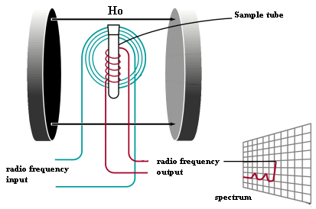
NMR Nuclear Magnetic Resonance
1. dumps into magnetic field
2. shoot radio wave
3. observe its stabilizing signal
Does not require crystal materials
Though need “mg” amount of stuff
Similar technology is used for MRI

Slide 7
Background

Slide 8
Some history
1916 the model of X-ray Crystallography founded
1938 started to sell Electron microscope
Same year, first success on NMR experiment
1953 James Watson and Francis Crick found DNA Model of double helix
However...
1. Cost
2. Not much organizing system

Slide 9
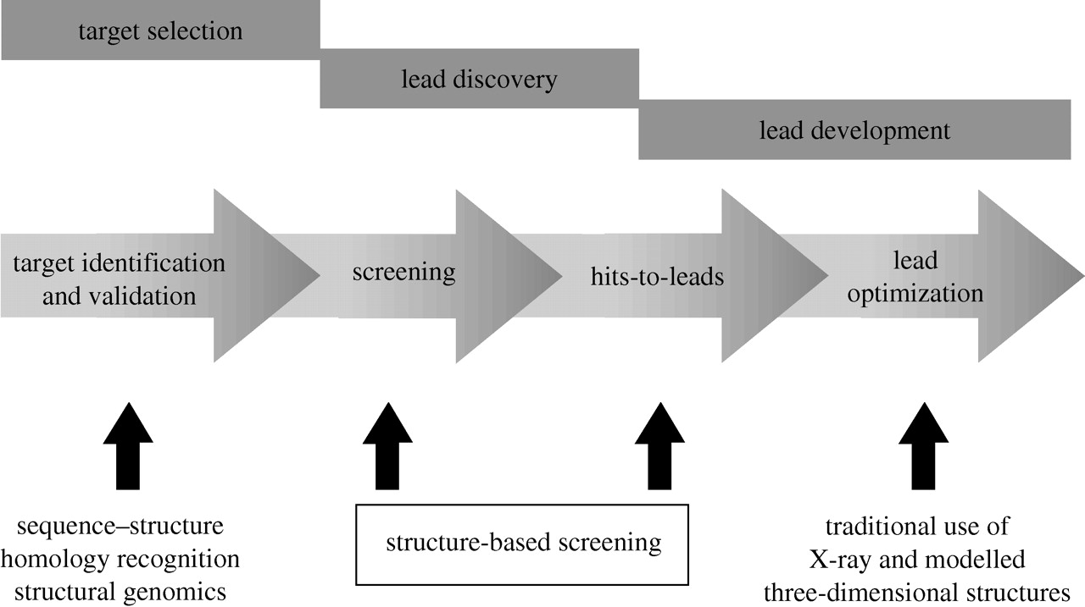
Lead optimization- Drug Inventions
Now its structural biologist and our turn to assist all the steps!

Slide 10
Profiling the structure and folding

Slide 11
Using FUGUE for profiling
http://mizuguchilab.org/fugue/
program for recognizing distant homologues by sequence-structure comparison
Approach is to exploit environment-dependent substitution matrices and gap penalties

Slide 12
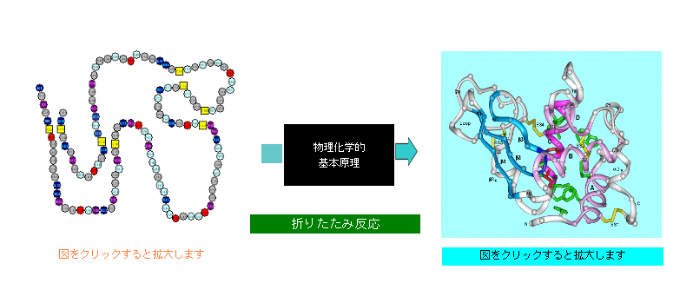
Folding
Native state Denatured state
Though this blackbox process is not fully revealed we know that some proteins tend to fold in particular shapes

Slide 13
Compare compare compare...
COMPOSER
3D-JIGSAW
MODELLER
Basically probability density functions derived from homologous structures and general features
Very helpful if the sequence identity is greater than 30% = great alignment
Not much versatile to something totally new (insertion)

Slide 14
CHORAL
program for modelling families or superfamilies showing low sequence identity
structurally conserved clusters (SCC) which use as much of the information available as possible for a protein family and also introduce new strong geometric requirements towards a sufficient condition for structural conservation.
One family of proteins have similar structure
percentage sequence identity and proportion of numbers similar to the family
CHORAL - amalgam of differential geometry and pattern recognition algorithms to identify the conserved structural patterns in homologous protein families
Retrospective prediction = post-diction

Slide 15
Target validation and identification

Slide 16
NEED FUNCTIONS!
Profiling of genes and proteins are mostly retrospective prediction
Now spending a lot of time to come for some sort of equation to define the structure
Attempts to define PROTEIN RESIDUES

Slide 17
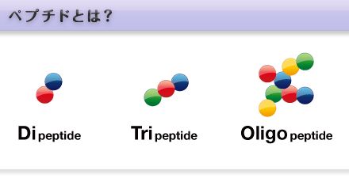
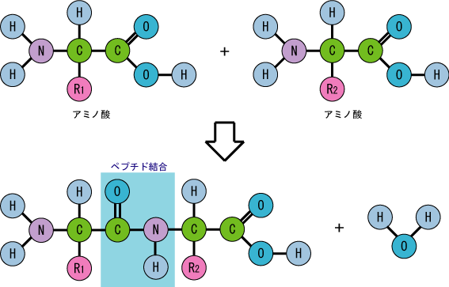
Protein Residue
A B
Peptide Bond
Like solving Married Brazilian name
António Silva Abreu Melo
But in proteins case, the residues could differ due to the peptide knocking off from the original amino acid
Amino acid
Residue
Amino acid
Residue

Slide 18
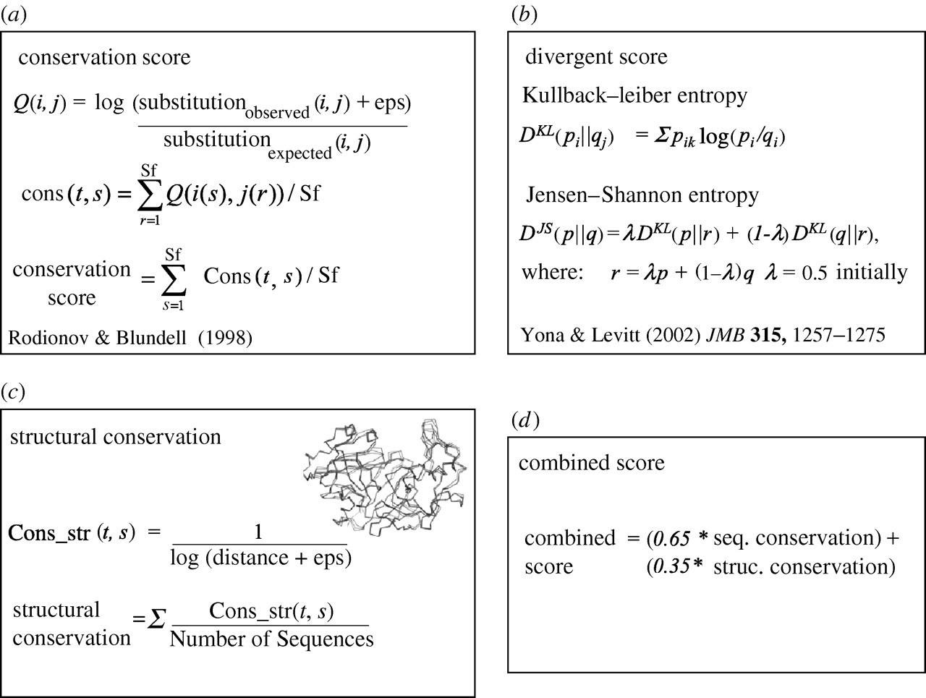
ESST Environment Specific Substitution Table
A. This score quantifies the degree of sequence conservation at an alignment position compared to the average conservation
B. quantifies the overall difference, or divergence
C. conservation of local structure in homologous families
D. functional site prediction

Slide 19
FD-ESST function dependent ESST
Functional restraints = effects of two proteins merging, proteins at particular circumstance, and comparing two total different proteins
Could be useful for finding sequence identities lower than 30%

Slide 20
Lead Discovery

Slide 21
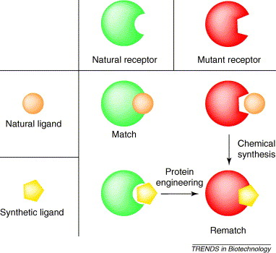
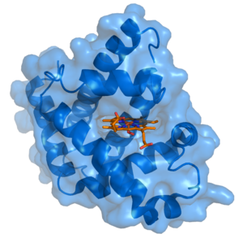
Ligand
the ligand is usually a molecule which produces a signal by binding to a site on a target protein. The binding typically results in a change of conformation of the target protein.
Has tendencies to have similar ligand if its in similar family
This ligand could be nailed in by finding the good match

Slide 22
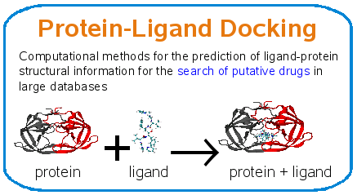
Ligand docking ranking
1. get protein
2. dumpin the ligand
3. look for better combination(compound)
This is conceptually “fragment” searching

Slide 23
NMR - Nuclear Magnetic Resonance X-ray Crystallography comes in
Can observe the protein ligand and its compound very well
If the compounding still works, we can make it to bigger + complex
ligand complexes by interpreting and analyzing the X-ray data without the need for manual intervention

Slide 24
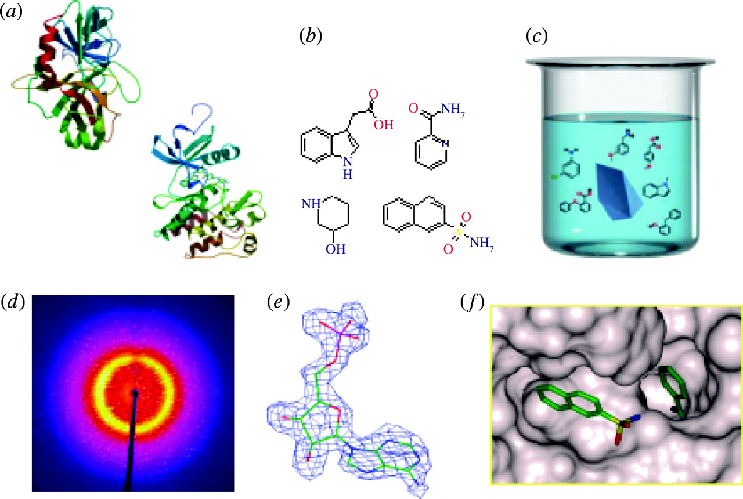
The actual process round-up
A.High resolution target structure determination.
B. Generation of Astex drug fragment library. Virtual screening used to enrich the library for fragments likely to bind the target.
C. Drug fragment cocktails used for protein crystal soaks, 4–8 compounds per cocktail.
D. High throughput protein/ligand X-ray crystallography. Automated X-ray data collection and analysis.
E. Electron density analyzed by AutoSolve in order to identify bound drug fragment.
F. Structure-based optimization of hits to leads.

